Slide 1
18ECO134T – Sensors and Transducers
Unit III : Session 8 : SLO 2
SRM Institute of Science and Technology
‹#›
Notes:
Pl use Font Family : Arial Narrow
To enhance the teacher presentations and the overall comprehension of students, it allows to present their lessons in a more dynamic and effective way. Set a Learning Objective:
1. Write an Outline for Key Ideas
2. Give the Presentation About Education a "Why"
3. Share Techniques and Tips for the Topic
4. Teach With Visualizations
5. Use Animations Carefully
‹#›

Slide 2
Geiger Counters

Slide 3
Geiger Counters
Its also called as Geiger –Muller Counter.
Mostly used Gas filled counter.
A Geiger counter is an instrument used for detecting and measuring ionizing radiation. Also known as a Geiger–Müller counter (or Geiger–Muller counter).
It is widely used in applications such as radiation dosimetryIt is widely used in applications such as radiation dosimetry, radiological protectionIt is widely used in applications such as radiation dosimetry, radiological protection, experimental physicsIt is widely used in applications such as radiation dosimetry, radiological protection, experimental physics, and the nuclear industry

Slide 4
Geiger Counters
It detects ionizing radiation such as alpha particlesIt detects ionizing radiation such as alpha particles, beta particlesIt detects ionizing radiation such as alpha particles, beta particles, and gamma raysIt detects ionizing radiation such as alpha particles, beta particles, and gamma rays using the ionization effect produced in a Geiger–Müller tube, which gives its name to the instrument.^{[1]} In wide and prominent use as a hand-held radiation survey instrument In wide and prominent use as a hand-held radiation survey instrument, it is perhaps one of the world's best-known radiation detection instruments.
It can be made to have longer operating life time by particularly using Halogen gas filling.

Slide 5
Geiger Counters
The commercially available varieties are
End-Window type.
Cylindrical type.
Needle type.

Slide 6

End-Window type

Slide 7
End-Window type
In the end window type, a metal coated glass tube of cylindrical form has a thin tungsten wire of 0.002-0.01 cm diameter passing through the centre acting as the collector electrode with the body as the other.
The end window s usually made of mica sheet of a thickness less than 1 mg/cm².
To avoid spark over the central electrode, it terminates into a glass bead .
Radiation is received by the end window.

Slide 8
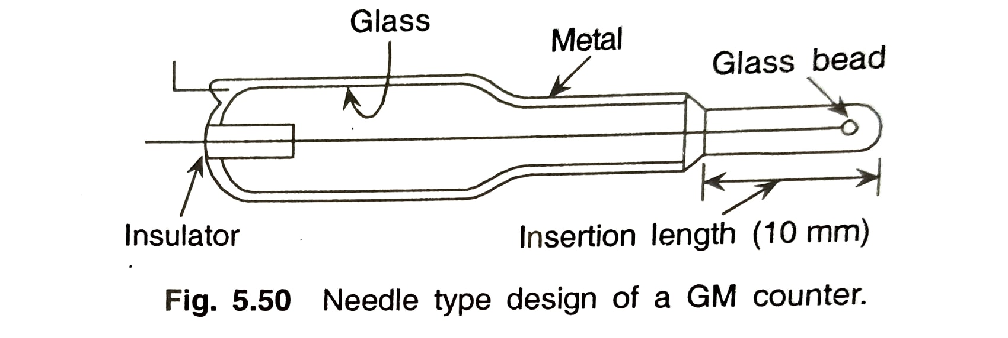
Cylindrical& Needle type
In the cylindrical GM counters,radiation is received by the side walls.
In the Needle type GM counter, where insertion in a narrow channel s required.

Slide 9
Geiger Counter
The GM counter chamber uses a gas at a low pressure of about 0.1-0.15 kg/cm² that consists of 90% insert gas such as Ar & Ne and 10% ethyl alcohol or other organic vapours like methane.
This mixture ensures charge transit through electrons only.
One important thing in gas filled counters is the discharges mechanism.
In the GM counter, the Townsend discharge occurs and with the bulk of electrons in the discharge being collected by the anode, a positive ion sheath or cloud is left to reduce the field and stop the discharge. This is known as Quenching of the discharge.

